Slide 1
SUPPORT BUNDLE ANALYZER
PROJECT-37542
BINEETA ORAM
KASIREDDY SRINIDHI
SHARVARI OKA
SHWETA

Slide 2
CONTENTS
Problem Statement
Proposed Solution
Implemented Solution
Future Plan for Scalability
Contribution
Demo

Slide 3
PROBLEM STATEMENT
When customer deploys our product, it is certain they will run into various problems with the product.
As part of the process, we ask them to generate a Support Bundle which later on is investigated by us.
This bundle comes as zip and is a collection of multiple files, logs, configurations, system files etc. It takes effort to investigate and find the problem.
Sometimes we overlook common and repetitive patterns which keep coming our way.

Slide 4
PROBLEM STATEMENT...
In the SaaS era customer service is the utmost priority.
After adapting the SaaS model we cannot afford to have our support team go through numerous log files for resolving the issues faced by the customer as that could take lot of time and effort.
Now is the time to automate that tedious process and reduce the time taken and increase the efficiency of the issue resolution process.

Slide 5
PROPOSED SOLUTION
We would like to automate support bundle analysis to reduce manual time and to be more accurate on finding problems.
We want to come up with the scalable framework ( sort of a scalable web app) where users should be able to upload the support bundle and system should be able to analyse customer environment, common patterns, may be predict the problem and assist with what could be done to remediate.
User should be able to upload new support bundle and should be able to extend rule/patterns through a UI editor or file (JSON).

Slide 6
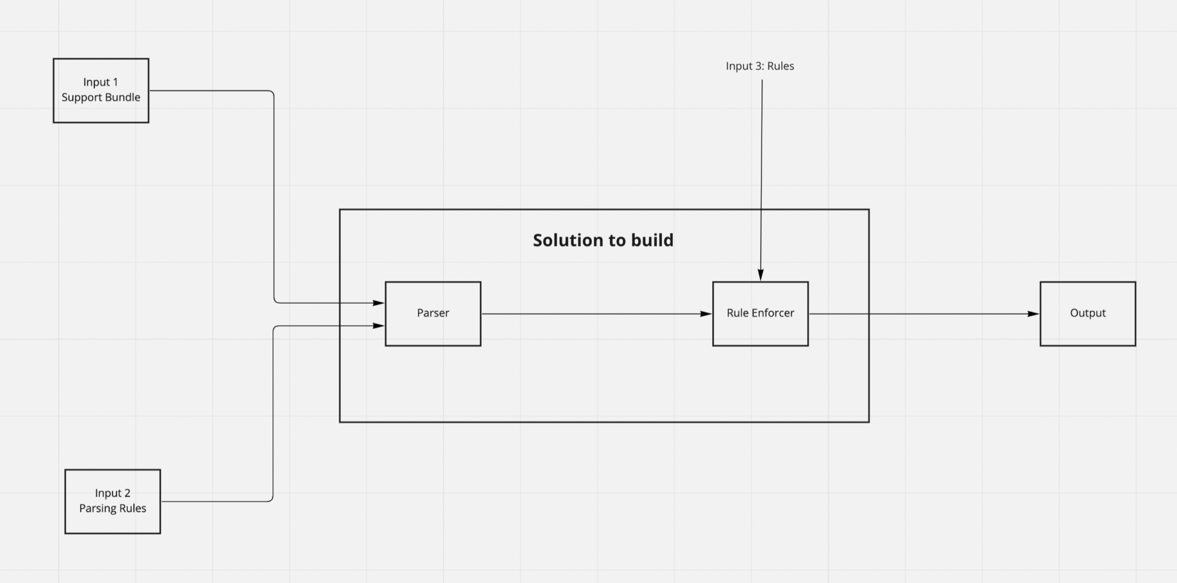
Design

Slide 7
Input 1: Input 1 is the support bundle uploaded to the
UI for automated analyses.
Input 2: It is the Parsing rules provided as per support
bundle or product specific, so that parser can parse the
files accordingly.
Parser: Parser is structuring the support bundle files
based on the parsing rules.
Input 3, Rules: Rules given to Rule enforcer to produce
desired output.
Rule Enforcer: Rule enforcer takes in the output from
parser and input 3 and produces the desired output.

Slide 8
IMPLEMENTED SOLUTION
We have implemented support bundle analyzer using command line interface which has various functionalities.
The user has to provide the name of the log file which he/she has to inspect.
After uploading the log file, the user has the option to see the type of logs(error/warn/info) of own his choice.
The user also has the choice of choosing a time frame in which he/she wants to access the logs.

Slide 9
If the user opts to access the errors in the bundle, all the errors are displayed and user has the option check if a solution of an error which he/she chooses.
In case the solution of an error is unavailable and the user resolves it for the first time, the user can upload the solution along with the error so that from next time the solution gets displayed when we come across that error.

Slide 10
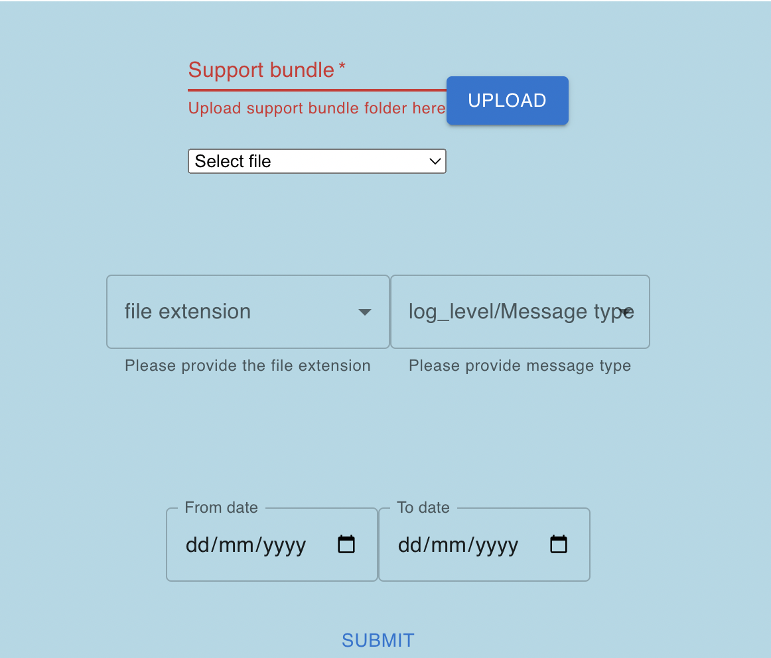
UI INTERFACE

Slide 11
FUTURE PLAN FOR SCALABILITY
Designing a web application to make the implementation interactive.
Database creation for storing new errors and respective solutions.
Uploading support bundle to access the files.
Integrating AI/ML models to make the system scalable.

Slide 12

DEMO

Slide 13
THANK YOU

